Slide 1
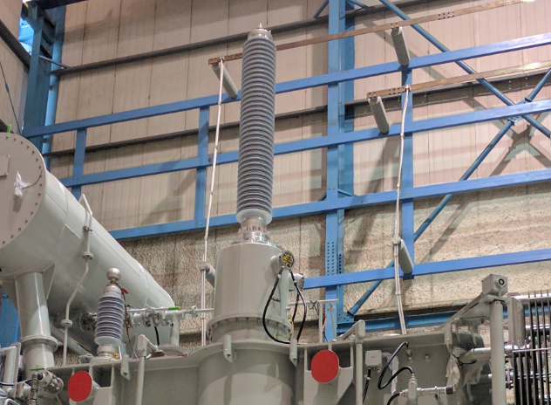
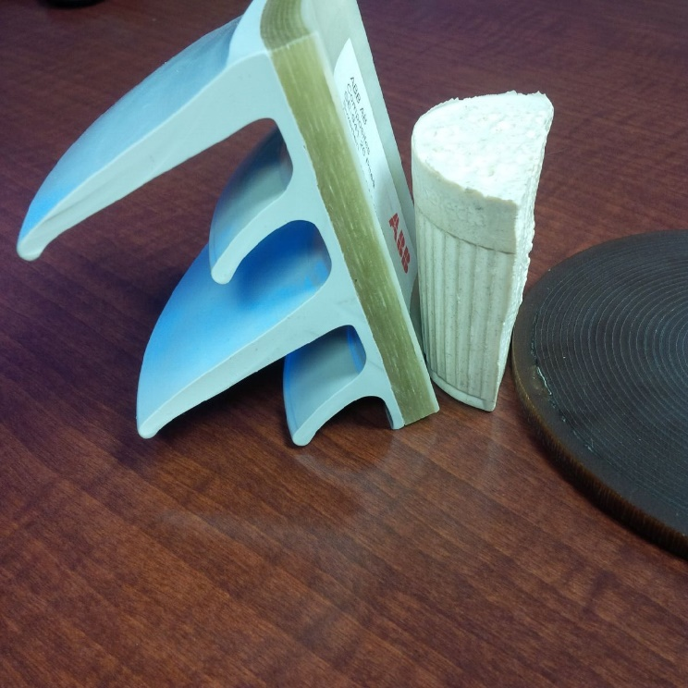
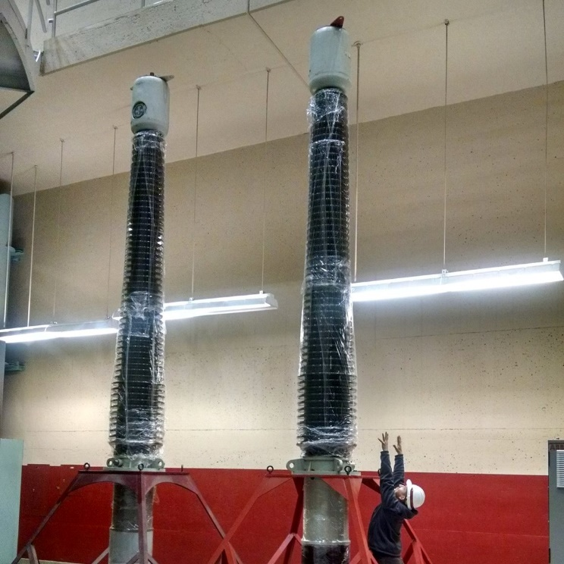
The Tale of Two Bushings A (poorly) illustrated guide to power factor testing
Brandon Bouwman, P.E.
Electrical Engineer
Generation Equipment Section
Hydroelectric Design Center
8 October 2020

Slide 2
Definitions: using the same dictionary
Bushing IEEE Definition: An insulating structure including a through conductor, or
providing a passageway for such a conductor, with provision for mounting on
a barrier, conducting or otherwise, for the purpose of insulating the conductor
from the barrier and conducting current from one side of the barrier to the other.
Simplified Definition: Component that allows passing high voltage and/or power
through something that should not be high voltage and/or power
Conductor any material that readily conducts electricity
Insulator any material that readily insulates against electricity
Shed the outer portion of a bushing that protects from weather
Voltage measurement of how many electrons are piled up in one spot
Current measurement of how many electrons move through one spot

Slide 3
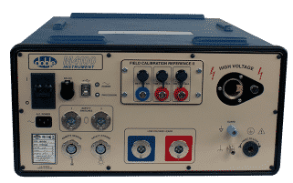
Definitions: using the same dictionary
Insulation Power Factor testing
IEEE Definition: The ratio of the power dissipated in the insulation, in watts, to
the product of the effective voltage and current in Voltamperes, when tested
under a sinusoidal voltage and prescribed conditions.
Note: The insulation power factor is equal to the cosine of the phase angle between
the voltage and the resulting current when both the voltage and current are sinusoidal.
Simplified Definition: The amount of energy that didn’t go where we wanted
Doble power factor testing
Same thing, but the test is done by a blue colored
box owned by Doble (a “Kleenex” type of situation)

Slide 4
Types of Bushing Construction
Bushing Type | Construction | Typical Application
Solid Bulk | homogenous solid, such as epoxy | Low Voltage
Oil Impregnated Paper (OIP) | Alternating layers of paper and conductive material, Filled with oil | Low Voltage High Voltage and High Voltage Neutral
Resin Impregnated Paper (RIP) | Alternating layers of paper and conductive material, Filled with resin and cured under pressure (solid) | High Voltage and High Voltage Neutral
Resin Impregnated Synthetic (RIS) | Alternating layers of polypropylene mesh and conductive material Filled with resin and cured under pressure (solid) | High Voltage and High Voltage Neutral

Slide 5
The Deep science behind insulators
Atoms with extra valence electrons
Atoms with less valence electrons
I NSULATOR
Eh, I don’t see a clear path. Let’s stay here
Come Hang out with us! Plenty of room!

Slide 6
The Deep science behind CONDUCTORS
Atoms with extra valence electrons
Atoms with less valence electrons
CONDUCTOR
It’s so easy, party over there!
Come Hang out with us! Plenty of room!

Slide 7
The Deep science behind NON-IDEAL INSULATION
Atoms with extra valence electrons
Atoms with less valence electrons
NON
-
I
DEA
L
I
NSULATOR
It’s going to take a while. Single file only
Come Hang out with us! Plenty of room!

Slide 8
Very simplified bushing diagram
High Voltage line
COPPER
Insulation
Insulation
Shed
Shed
Transformer Tank

Slide 9
Very simplified bushing diagram
“ideal”
“reality”
High Voltage line
COPPER
“reality” insulation is never 100% insulating and is subject to degradation from various environmental and operational stresses
“ideal” insulation will be 100% insulating and last forever
Insulation
Insulation
Shed
Shed
Transformer Tank

Slide 10


Power Factor test
“ideal”
“reality”
High Voltage line
COPPER
Insulation
Insulation
Shed
Shed
Transformer Tank

Slide 11
Power Factor test
“ideal”
“reality”
High Voltage line
COPPER
Insulation
Insulation
Shed
Shed
Transformer Tank

Slide 12
Power Factor test
“ideal”
“reality”
High Voltage line
COPPER
Insulation
Insulation
Shed
Shed
Transformer Tank

Slide 13
Key points
These are very small numbers
To track changes in results, we need to identify even smaller amounts – micro-amperes
Which means this is a very sensitive test
Because we measure very small numbers, even minor surface contamination skews results
The test does not provide good results if it’s raining, dusty, very high humidity
Test conditions should be as close as possible each time – often means similar times of year with typically good weather
Since the test requires climbing on the transformer / an outage, this is also the time to look for leaks, cracked insulators, and other signs of damage that cannot be seen from the ground or known from sensors until they are catastrophic
The example shown was a bushing, but it’s the same for many types of insulation systems (generators, transformers, bus duct, motors, etc.)

Slide 14
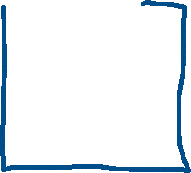




Critical powertrain

Slide 15
Key points
Testing more systems at once seems easy, in theory
Except it requires more clearance points, lock-out / tag-out is more complex, prep is more complex, and potential issues found increases
All of these increase the time, such that there may be better economies of grouping work into different outages
A test that is rushed may not be accurate
Technicians need time to perform their duties and skillsets effectively
While the equipment is in a safe configuration, even the test sets themselves are producing high voltages, while working at heights, in an exposed environment – many risks stacked
Relative to the lifespan of the equipment, and uptime within a given year, testing is a minimal amount of time

Slide 16
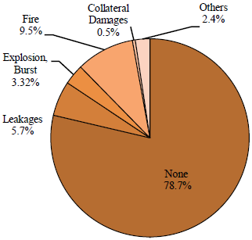
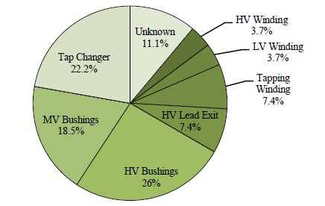
Risks of bushing failures
External Effects of Major Failures
Failure Location of substation transformer where Fire or Explosion occurred

Slide 17
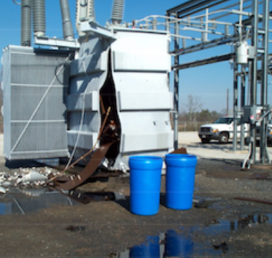
Environmental AND SAFETY
Mineral oil spills onto soil or into waterways must be remediated
Risk to aquatic life
Particularly challenging with
limited space on tailrace decks
- extra-high voltage transformers, and high current bushings in isolated phase bus duct (all low voltage in NWW) are subject to greater stresses than distribution class transformer bushings
Tank split due to fault
(not a USACE unit!)

Slide 18
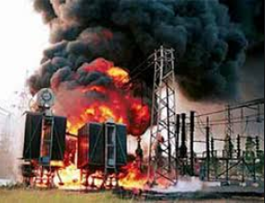
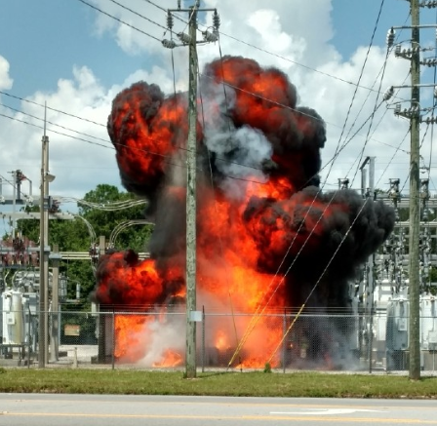
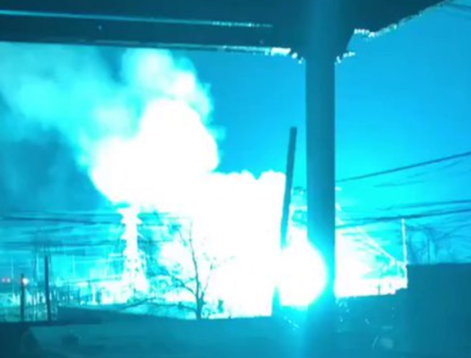
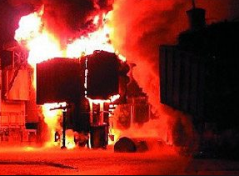
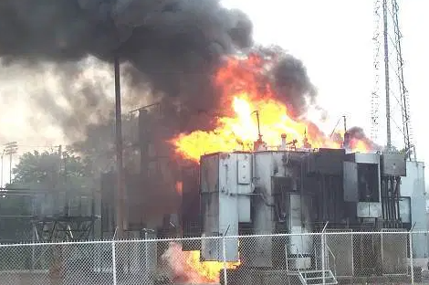
Environmental AND SAFETY
Transformers pass SIGNIFICANT energy, and the potential fire energy of 5,000 or 10,000 gallons of mineral oil is substantial

Slide 19
Questions?
I glossed over many details / nuances to clearly communicate the basic concept
If you’re an experienced electrical person, please forgive me

